Slide 1

Vegan restaurants in Prague
Exploratory analysis

Slide 2
Agenda
Introduction
Data
Methodology
Results
Discussion
Conclusion

Slide 3
Introduction
Vegan restaurants are not easy to come by
Veganism has been growing worldwide
Prague comes up in the top 5 of most vegan restaurants per capita in the world
The objective is to visualize the major areas of Prague that have good Vegan restaurants.

Slide 4
Data
Prague data that contains a list of districts and areas
Foursquare data

Slide 5
Methodology
Collect Prague data and convert to csv
Get latitude and longitude values for each area through geocoder
Use Foursquare API to explore Vegetarian/Vegan restaurants in the different areas of the city of Prague
Find all venues for each neighborhood, filter the Vegetarian/Vegan restaurants, and find the ratings for each
Sort the restaurants by rating in order to find the ones with the best score, by district and by area
Visualize the data with folium

Slide 6
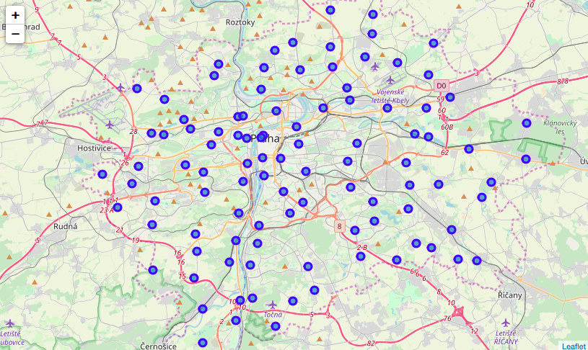
Results
The city of Prague counts with 22 districts and 113 areas

Slide 7
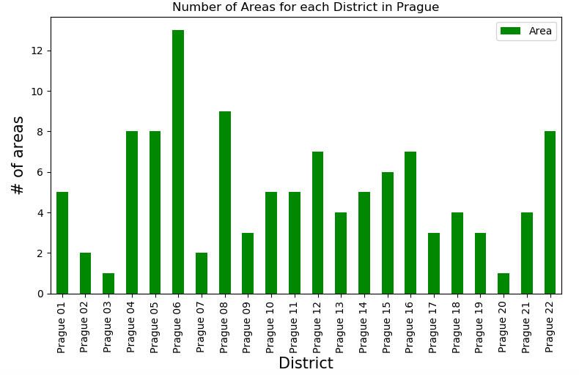
Results
In the chart below we can observe the number of areas per district, being 6 the district with the highest number of areas

Slide 8
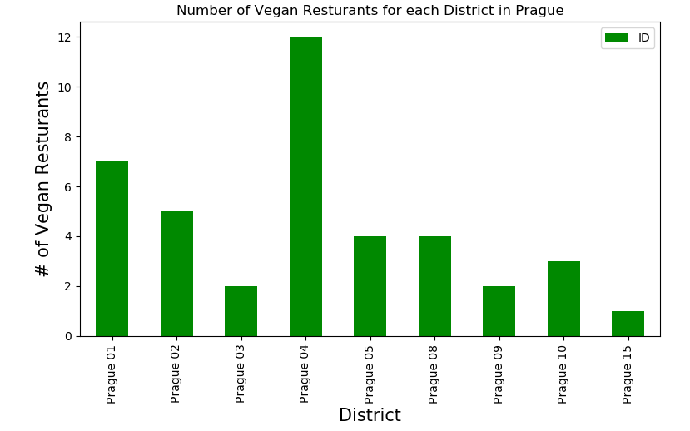
Results
This is how the 40 vegan restaurants in Prague are spread across districts, being 4 the district with more restaurants

Slide 9
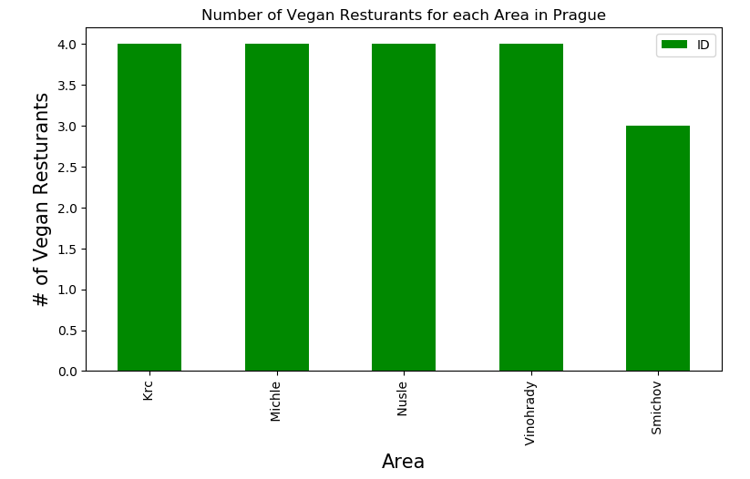
Results
The areas with the highest number of vegan restaurants are Krc, Michle, Nusle and Vinohrady

Slide 10
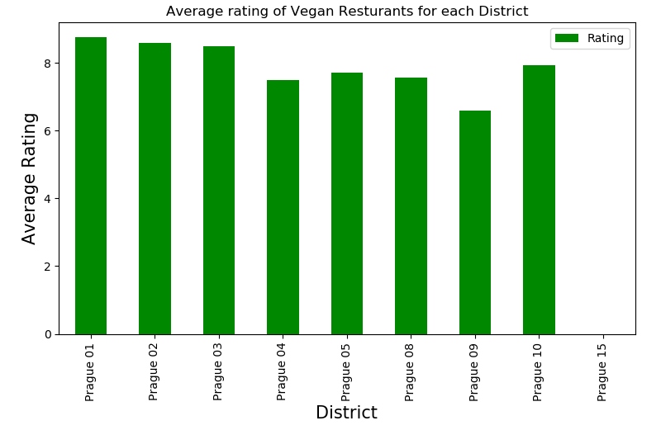
Results
The restaurants with the best average rating are in Prague 1, Prague 2 and Prague 3

Slide 11
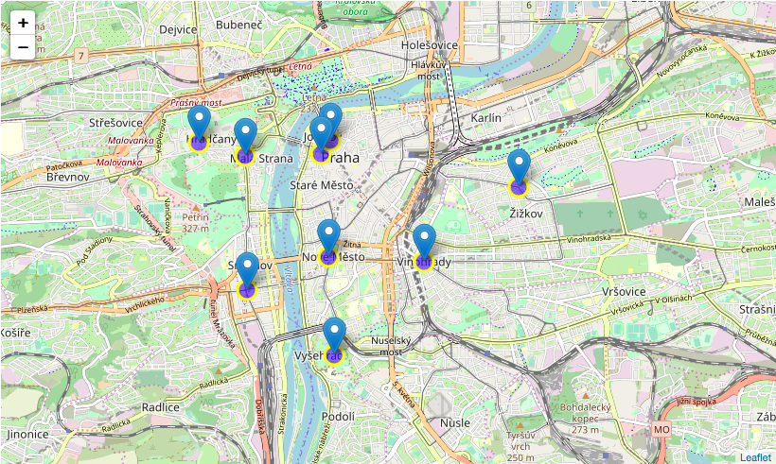
Results
Location of restaurans with average rating equal to or higher than 8.0

Slide 12
Conclusion
Vysehrad, Lesser Town and Hradcany are some of the areas with better quality vegan restaurants
Prague 1 is potentially good to open new vegan restaurants, as the number is low compared with other districts and it is in the city center
Prague 6 also good, as it is a big district with a verly low nuber of restaurants
If you are a vegan, Prague 4 is the best place to establish a residence or to explore vegan cuisine

